Slide 1

Midterm Project Presentation
—— OYO rental price prediction in China
Brown University, Data Science Initiative,22fall
GitHub: https://github.com/AstrosiosaurQ7/data1030_mid_proj
19/10/2022
Xiaoyan Liu

Slide 2
Content
1
Introduction
2
EDA Exploratory Data Analysis
3
Splitting and preprocessing

Slide 3

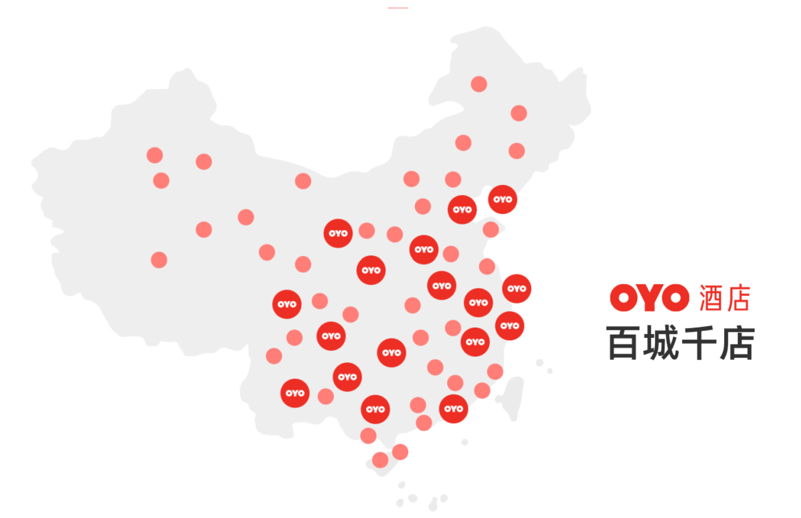

01
Intro
OYO Intro
OYO Hotels & Homes
franchise operation
OYO hotels’ distribution in China

Slide 4
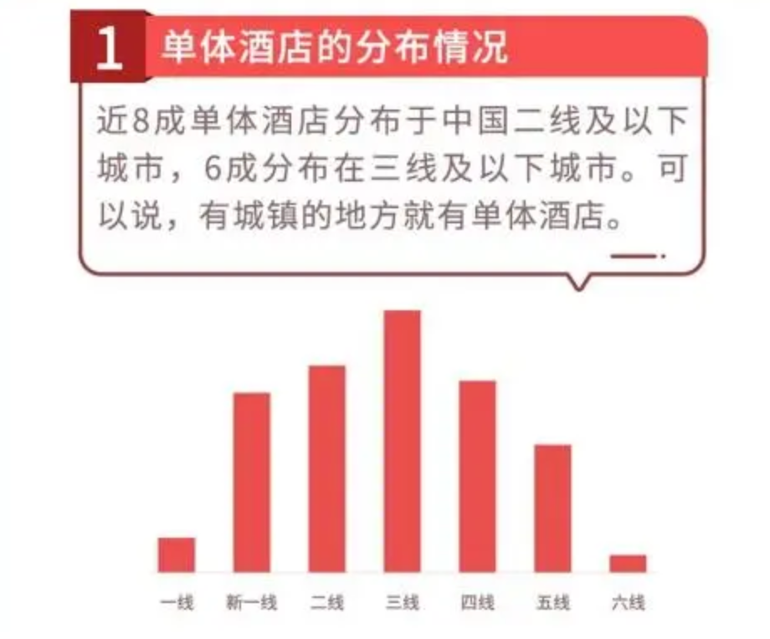
01
Intro
Problem
Feature matrix shape
(5834,25)
Target variable shape
(5834, )
1 Independent hotels’ distribution
Nearly 80% of independent hotels are located in second-tier and below cities in China. 60% are distributed in third-tier cities and below. It can be said that where there are towns, there are individual hotels.
This report hopes to predict the rental price of OYO hotels according to the property type 、hotel location and so on.
<<Hate and Love of Chinese Independent Hotel Owners: Big Data Report of Chinese Independent Hotel Owners>>
——OYO Industry Analysis Report

Slide 5
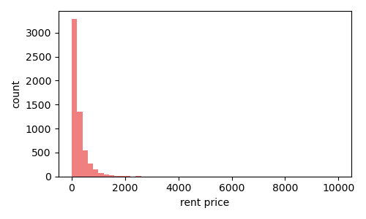
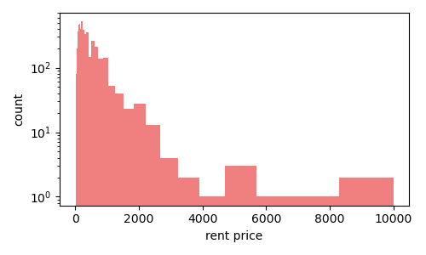
01
Intro
Problem
Target variable ：rental price / $
Enlarge the coordinate axis by log function
Regression / Right-skewed

Slide 6








01
Intro
Data From
OYO APP
XieCheng
MeiTuan
Fei zhu
OYO APP , Chinese OTA platform : XieCheng / MeiTuan/FeiZhu
Oyo Rental Price Prediction in China | Kaggle
Kaggle

Slide 7
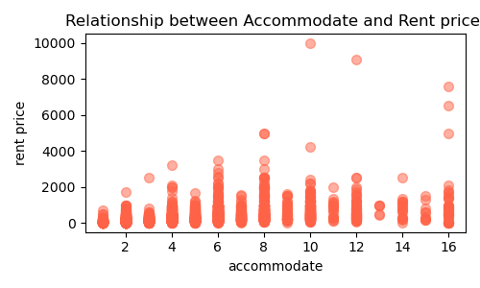
02
EDA Exploratory Data Analysis
Num classification
Special point
Scatter of Accommodate and Rental price
Bar plot can't show unusually high prices.

Slide 8
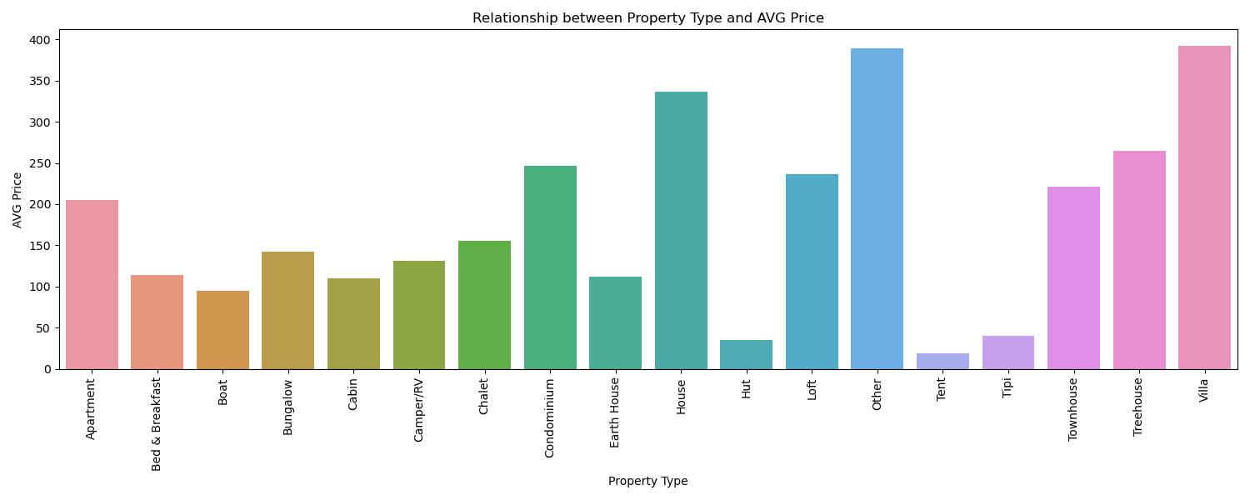
02
EDA Exploratory Data Analysis
classification
Property Type and AVG Price

Slide 9
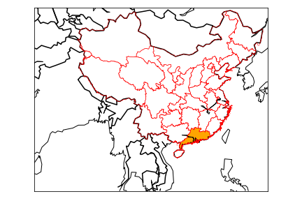
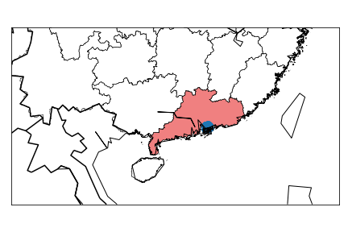
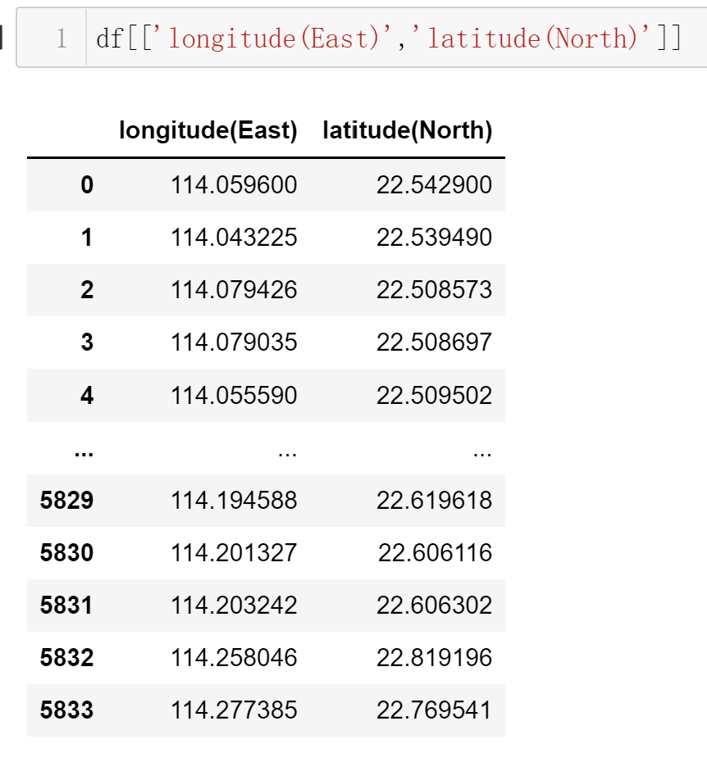
02
EDA Exploratory Data Analysis
location
Most hotels are concentrated in the surrounding cities of Shenzhen and Hong Kong, which are near to the seaport and have developed tourism and economic industries.

Slide 10
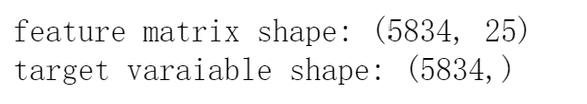
03
Splitting and preprocessing
splitting
60%
50%
X_train, y_train
X_val, y_val
100%
40%
50%
Dataset
& iid
X_other, y_other
X_test, y_test

Slide 11
03
Splitting and preprocessing
preprocessing
OneHot Encoder
Ordinal Encoder
MinMax Scaler
Features:
Classification
Categories can’t be ordered
Features:
Categories
Categories can be ranked or orderd
Features:
Continuous
Feature values are reasonably bounded
Standard scaler
Features:
Continuous
Continuous features follow a tailed distribution

Slide 12
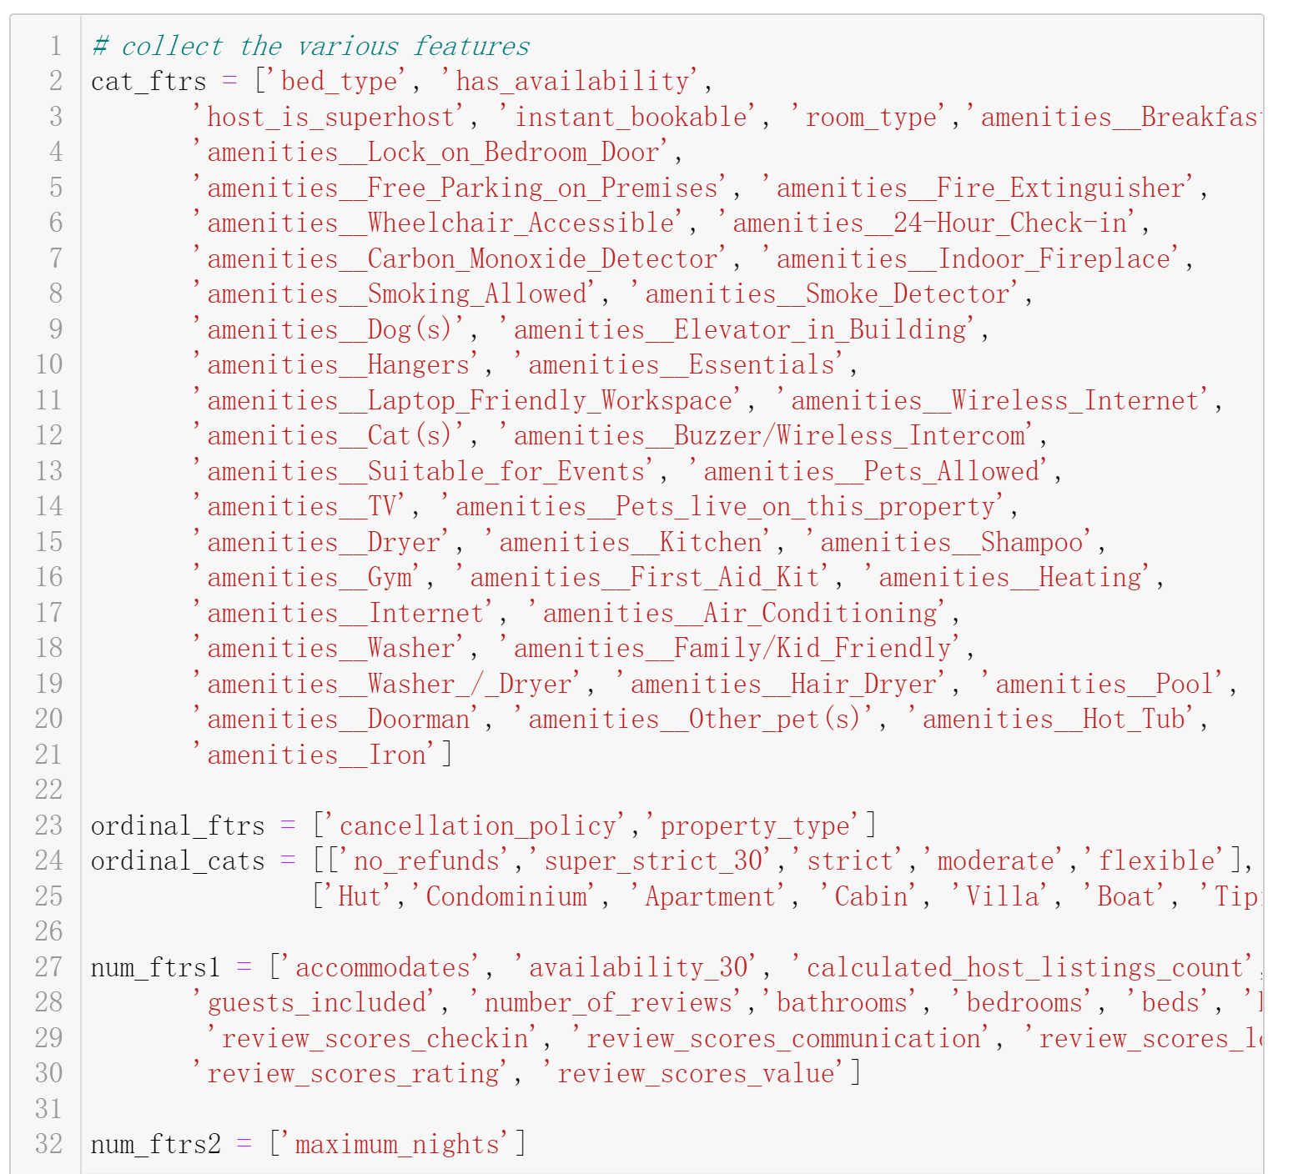
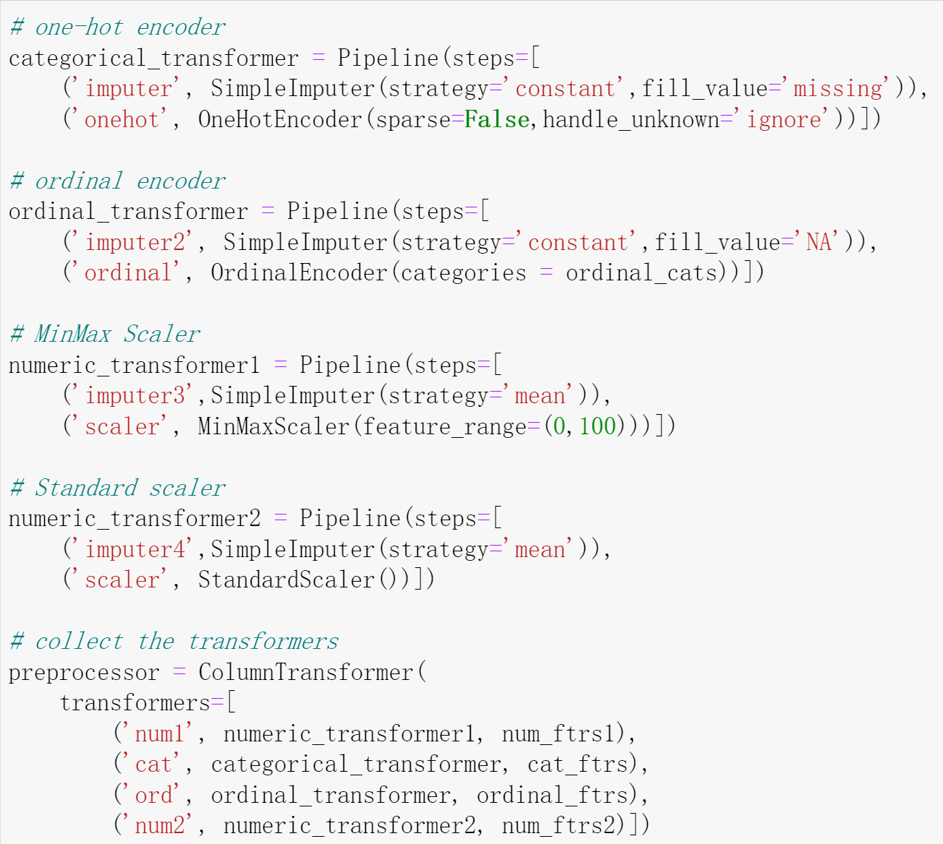
03
Splitting and preprocessing
preprocessing-backup

Slide 13
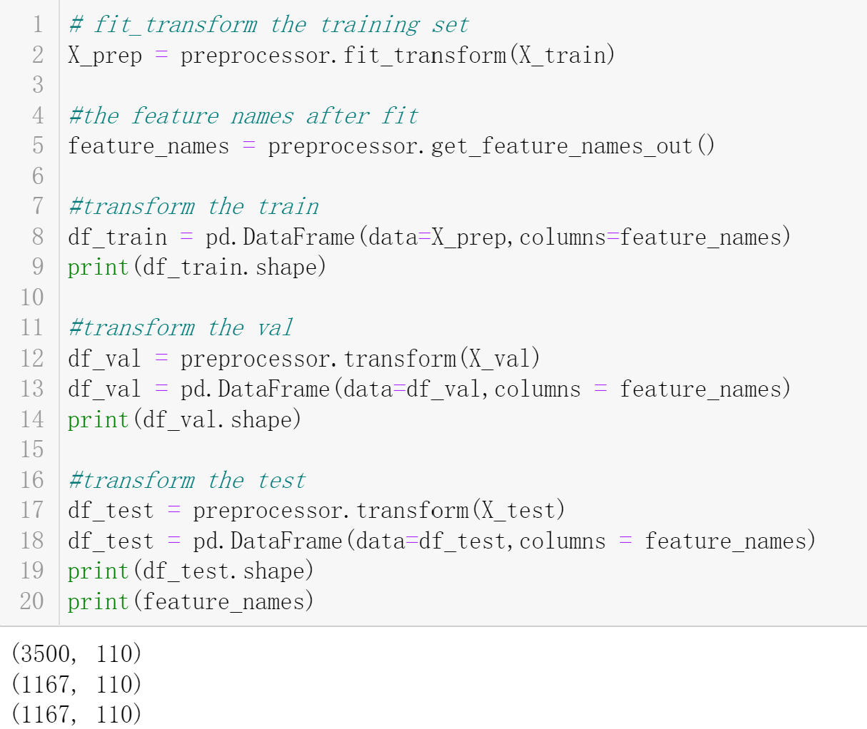
03
Splitting and preprocessing
preprocessing
Rows:5834
columns:25
after preprocessing
Rows:5834
columns:110

Slide 14
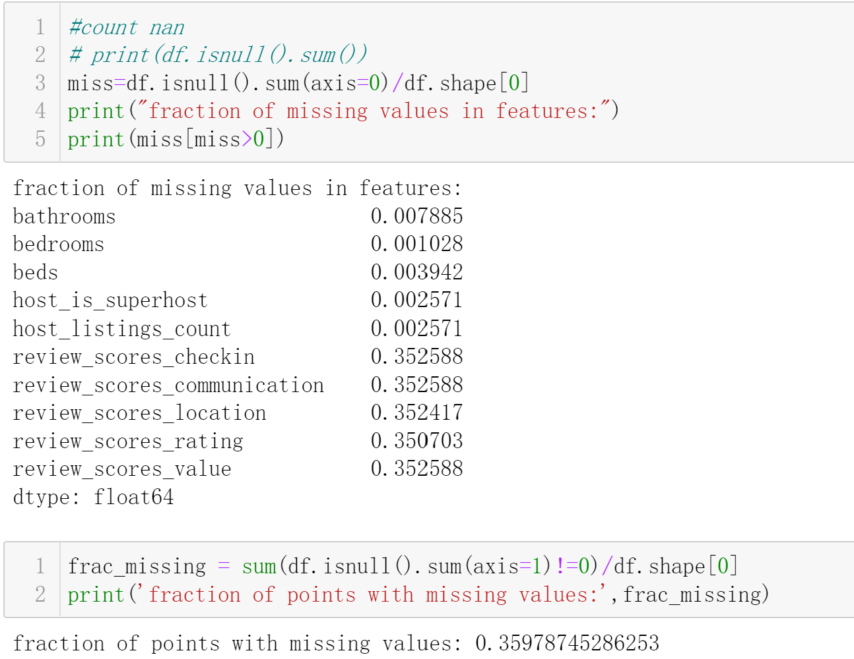
03
Splitting and preprocessing
missing
Fraction of missing values in features:
10 features
Fraction of points with missing values:
35.7%

Slide 15
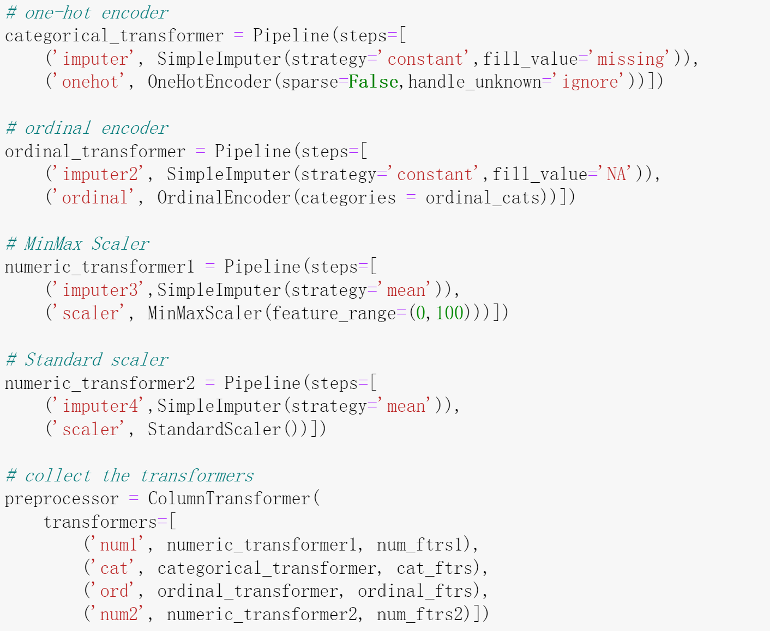
03
Splitting and preprocessing
missing
Missing
NA
Mean
Mean

Slide 16
THANK YOU FOR WATCHING

